Slide 1
1.6.8.5 The complex conjugate

Slide 2
Introduction
In this topic, we will
Define the conjugate of a complex number
Look at both rectangular and polar representations
Look at a geometric interpretation
Observe some properties

Slide 3
Review
Recall from secondary school that when you rationalized the denominator of an expression, such as
You referred to as the conjugate or radical conjugate of the denominator

Slide 4
The complex conjugate
Recall that and so, given ,
it is reasonable to define the complex conjugate of z as
One common use of the complex conjugate is to do exactly that:
Rationalize the denominator
This converts the ratio of complex numbers into the rectangular representation

Slide 5
The complex conjugate
Some examples:

Slide 6
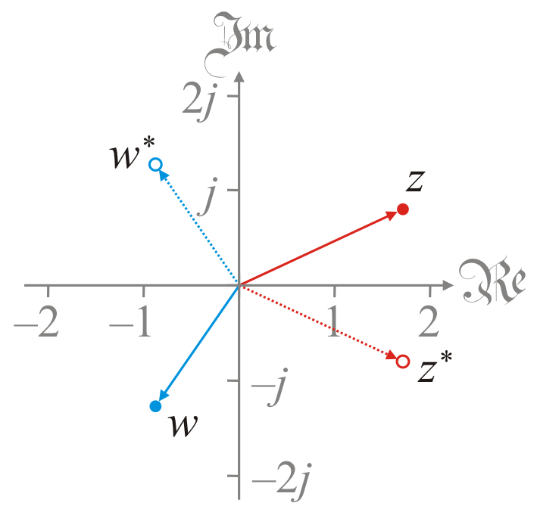
Geometric interpretation
The geometric interpretation of the complex conjugate is a reflection through the real axis

Slide 7
Polar representation
If a complex number is in the polar representation, the complex conjugate is equally easy to find:
If then
To show this, just recall that
so

Slide 8
Polar representation
There are many useful properties of the complex conjugate
The proofs may be done with either rectangular or polar representations
We’ll use both

Slide 9
Properties
Theorem:
The conjugate of the conjugate of z is z
Proof: If , then
QED

Slide 10
Properties
Theorem:
z times the conjugate of z is the absolute value of z squared
Proof: If , then
QED

Slide 11
Properties
Theorem:
The conjugate of a sum is the sum of the conjugates
Proof: If and ,
QED

Slide 12
Properties
Theorem:
The conjugate of a product is the product of the conjugates
Proof: If and , then
QED

Slide 13
Properties
Theorem: if and only if z is real.
Proof: If ,
and
and
z is real
QED
Theorem: if and only if z is imaginary.

Slide 14
Properties
Theorem: and .
Proof: If ,
QED

Slide 15
Properties
Theorem: and .
Proof: See the previous theorem.

Slide 16
Properties
Theorem: .
Proof: If , then
QED

Slide 17
Important takeaways
The most important takeaways are
Complex conjugation is a reflection in the real axis
For most operations, it doesn’t matter if you
Reflect first and then perform the operation, or
Perform the operation and then reflect

Slide 18
Summary
In this topic, we’ve introduced the complex conjugate
It is a reflection in the real axis
Used to rationalize the denominator
We saw that
The conjugate of the conjugate of z is itself
For many operations, you can apply conjugation before or after the operation in question
The real and imaginary components can be extracted using conjugates

Slide 19
References
[1] https://en.wikipedia.org/wiki/Complex_conjugate

Slide 20
Acknowledgments
None so far.

Slide 21
Colophon
These slides were prepared using the Cambria typeface. Mathematical equations use Times New Roman, and source code is presented using Consolas.
The photographs of flowers and a monarch butter appearing on the title slide and accenting the top of each other slide were taken at the Royal Botanical Gardens in October of 2017 by Douglas Wilhelm Harder. Please see
https://www.rbg.ca/
for more information.

Slide 22
Disclaimer
These slides are provided for the ne 112 Linear algebra for nanotechnology engineering course taught at the University of Waterloo. The material in it reflects the authors’ best judgment in light of the information available to them at the time of preparation. Any reliance on these course slides by any party for any other purpose are the responsibility of such parties. The authors accept no responsibility for damages, if any, suffered by any party as a result of decisions made or actions based on these course slides for any other purpose than that for which it was intended.

